Slide 1
Biodiversity and Conservation
A Study of US National Parks

Slide 2
Species Data Background
Researchers recorded the number of times various species of plants and animals were spotted at four different US national parks over the course of one week. The parks involved are Great Smoky Mountains National Park, Yosemite National Park, Bryce National Park, and Yellowstone National Park.
The most commonly-observed species in each park were vascular plants, 99% of which are not under any federal protections.
About 97% observed species have a conservation status of “No Intervention,” meaning that they are not considered threatened and are not under any federal protections.

Slide 3
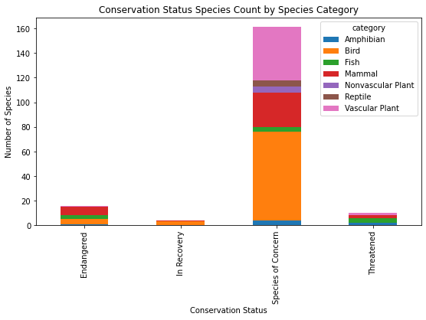
Protected Species
Most of the protected species in these parks have a conservation status of “Species of Concern,” meaning the populations are trending downward and action may be needed.
Out of the observed species, mammals and birds are the most likely to be protected, at 17% and 15%, respectively.

Slide 4
Statistical Significance of Conservation Status Differences
Based on an alpha of 0.05, mammals and birds are equally as likely to be protected. The chi-squared contingency table for the two categories produces a p-value of 0.16 and a chi-squared value of 0.69, indicating no statistically significant difference.
However, mammals are more likely to be protected than reptiles. The chi-squared analysis for those two categories results in a p-value of 0.04 and a chi-squared value of 4.3, indicating a statistically significant difference.
The same analysis on the difference in conservation status of reptile and birds is inconclusive, with a p-value of 0.05 and a chi-squared value of 3.7. These statistics are virtually identical to the critical values alpha (0.05) and the chi-square critical value (3.8), so the statistical significance cannot be determined conclusively in this manner.

Slide 5
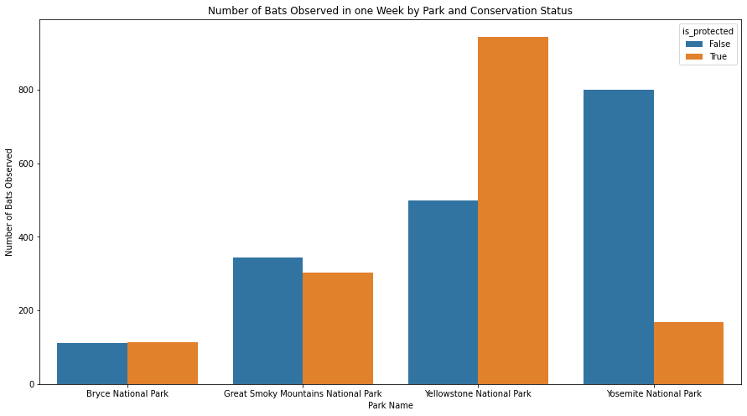
Mammal Conservation
Mammals are the most likely category to be under protection, and an investigation of the most commonly-observed mammal species revealed that bats were the most widespread mammal observed.
This graph shows the number of bats observed in the parks. Bats are most frequently seen in Yellowstone, where most of the individuals observed are protected, indicating that the conservation efforts there have been effective.

Slide 6
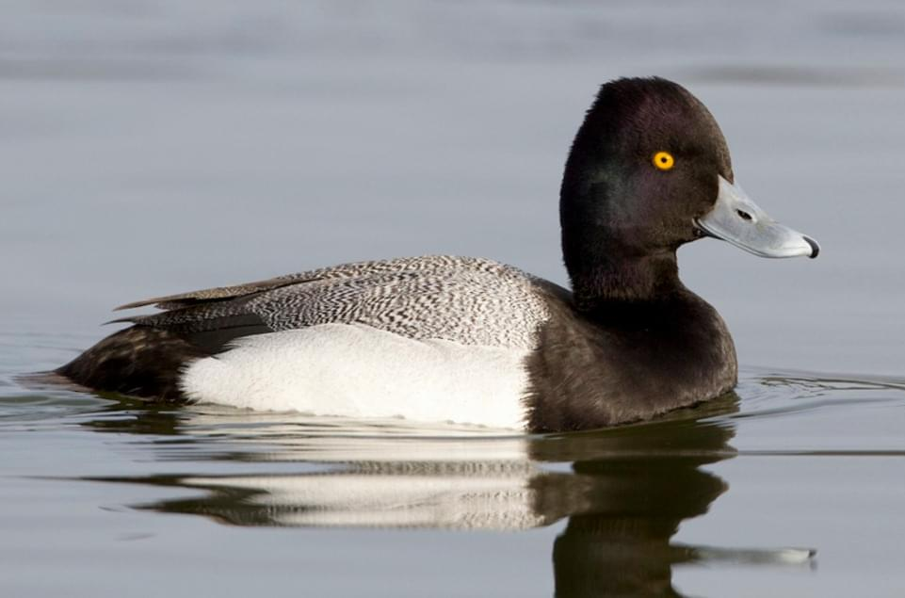
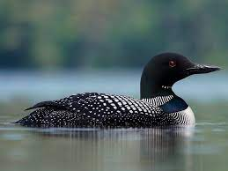
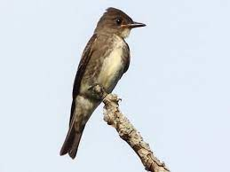
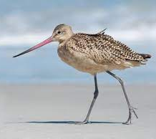
Bird Conservation
Birds are nearly as likely as mammals to be under protection. Unlike mammals, however, there is no clear pattern to the most commonly-observed species, other than the fact that none of them are under protections.
Of the most commonly-observed protected species in each park (right), 3 out of the 4 are waterfowl. This is not surprising, since waterfowl are facing more threats than most types of birds.
Smoky Mountains: Lesser Scaup
Yosemite: Common Loon
Bryce: Olive-Sided Flycatcher
Yellowstone: Marbled Godwit

Slide 7
Recommendations
As discussed previously, the most likely species in these parks to be federally protected are mammals and birds, so conservation efforts should emphasize those categories. Among mammals, bats are particularly prominent, so efforts should be made to preserve their habitats and food sources. Among birds, waterfowl and shorebirds are of particular concern, so conservation efforts should focus on preserving bodies of water and shorelines.

Slide 8
Limitations and Further Research
These observations took place over one week, so this data does not show fluctuations throughout different times of the year. It is also likely that the type of environment would impact what species are observed. For example, Bryce Canyon National Park is mostly desert-like, while Great Smoky Mountains National Park is heavily wooded mountains. There are also many other national parks not included in this study that would be of interest due to their different geographical features, such as the colder climate of Denali National Park or the warmer waters of Biscayne National Park.

